Slide 1
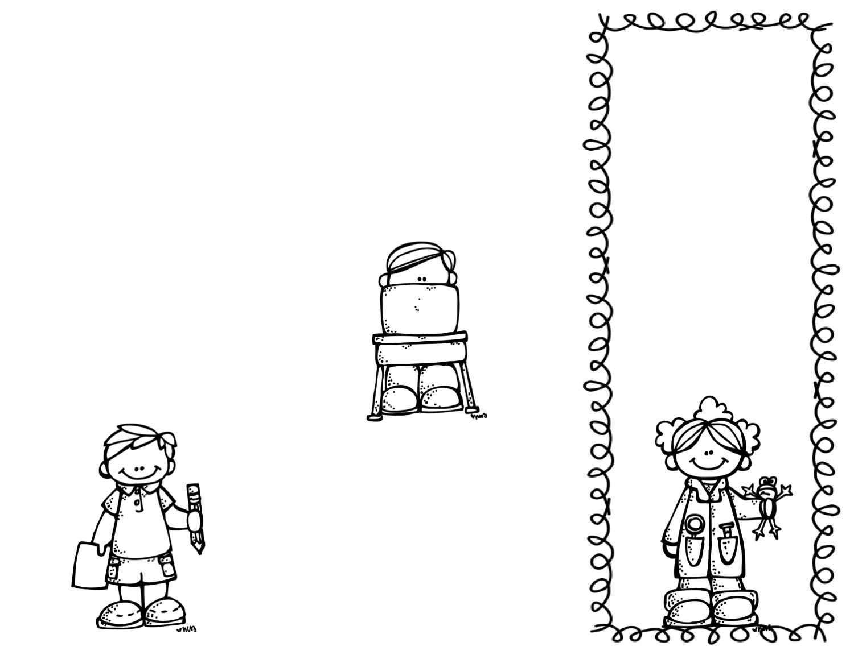
Hello!
Garrett Elementary
Welcome to 2nd grade! I am so excited to be your child’s teacher. I’ve created this handout to help answer some of the questions you may have regarding our school and classroom. Feel free to contact me via email or phone – both located on the back of this handout. I know we are going to have a wonderful year in 2nd grade!
1100 Eisenhower Drive, Augusta, GA 30904
Phone: 706-737-7222|
Fax: 706-737-1166
Welcome to Our Second Grade Class!
SCHOOL TIMES: 7:30AM-2:15PM
You will be marked tardy after 7:30AM. Please be aware of your child's absences.
Teacher Contact
Ms. K. Williams
Email- WilliKa2@boe.richmond.k12.ga.us
Phone- (706)-750-9019
Class Dojo

Slide 2
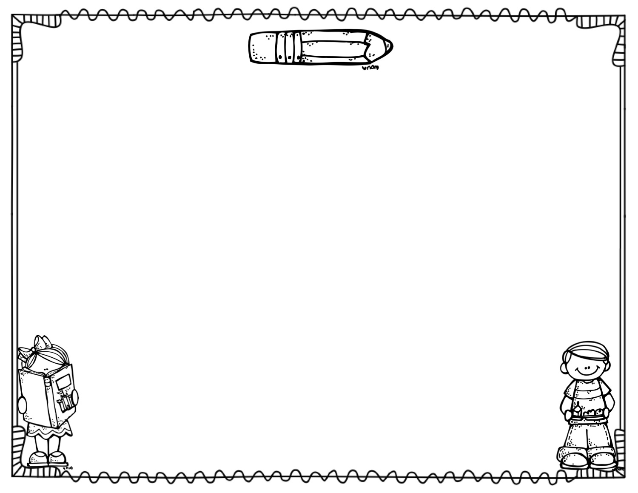
Communication
Homework
During the first week of school your child will receive an agenda. This communication book will go to and from school every day to communicate school & classroom news, behavior, and homework. Your child’s agenda needs to be signed each night. This is a great way for everyone to stay in communication, and you can write me notes about your child, behavior, sickness, etc.
Students will be given homework for extra practice . Please check and sign your child’s agenda for Homework Assignments and Conduct Grade EVERYDAY.
Our Beliefs
We believe our students will be successful and will learn. Learning will occur through various, creative strategies. Graphic organizers, class discussions, projects, and interactive notebooks will be used frequently in the classroom.
Grading Policy
Focus
We will continue using standards based grading this year.
Behavior
Language Arts: Phonics, Reading , Fluency, and Writing
Math: Number Sense, Fact Fluency, and Computation
Science: Raising questions, Seeking answers, and the Sun and Moon
Social Studies: Georgia History, Economics, and Government
Class DOJO will be used this year. Students can earn and loose points depending on the behavior in our classroom.
Each negative mark is a loss
of 5 points. The points will determine students’ conduct grade at the end of the day.
Assessments
Students’ progress will be tested weekly through i-Ready which will determine students’ yearly progress; along with weekly research based assessments congruent with the weekly lessons.

